Slide 1
Data Structures
Stacks
&
Queue
By: Junwoo A., Michael B., Gautham K., Sahil P. & Calvin Y.

Slide 2
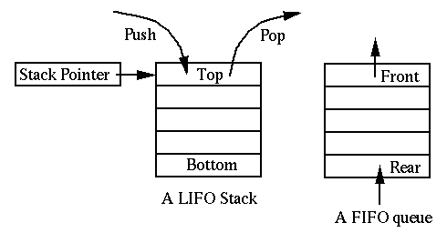
Stacks
A stack is an ordered list in which all insertions and deletions are made at one end, called the top.
Also known as the Last In First Out (LIFO) lists.
What identifies a stack data structure is not the implementation but the interface.
The user is only allowed to pop or push items onto the array or linked list.
http://www.cmpe.boun.edu.tr/~akin/cmpe223/chap2.htm

Slide 3
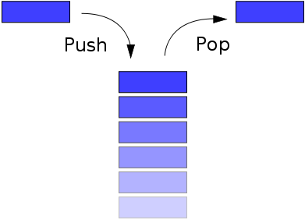
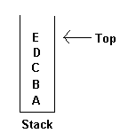
Stack is a linear list of elements.
This means that all the data is of the same type and stored in consecutive order, like an array or linked list.
You cannot do a selective removal of an element of your choice from the stack. Selective removal is possible in arrays and linked lists.
A stack may or may not have a boundary on it.

Slide 4
Some operation in a stack data structure include push(), pop(), size() - returns the # of elements in the stack, isempty(), top() - returns top element of the stack.
A stack pointer is used to refer to the top position of the stack. The stack pointer always points to the top element.
When an element is popped out of the stack, the stack pointer will point to the preceding element.
The benefit of implementing stack using a linked list is that memory space is not wasted and there is no limit on the size, while an array is limited by its size.
http://www.youtube.com/user/learnwithtechies

Slide 5
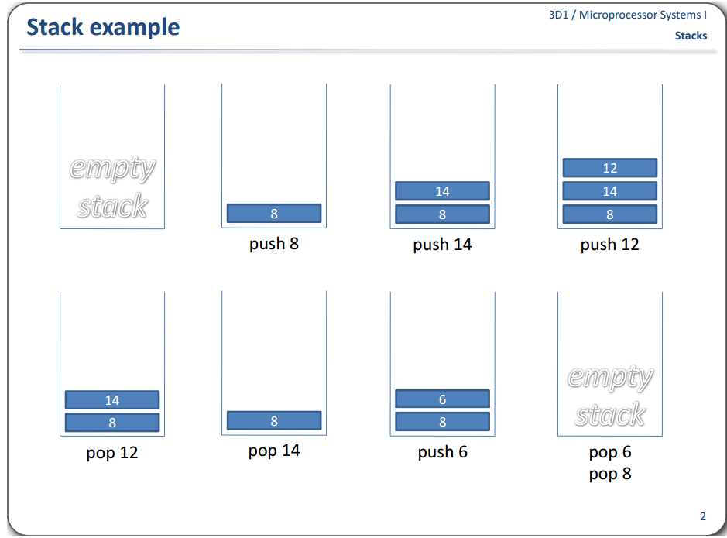

Slide 6
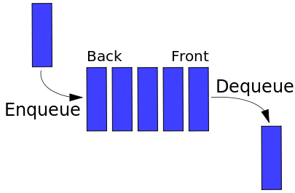
Queue
The concept of a queue data structure is similar to that if a stack structure. Additions are made to the end of the list or queue while removals are made at the front.
Also known as a FIFO structure (First-In First-Out)
A linear data structure (data is of the same type and stored in consecutive order, like an array or linked list.)
User is only allowed to enqueue or insert items and dequeue or remove items

Slide 7
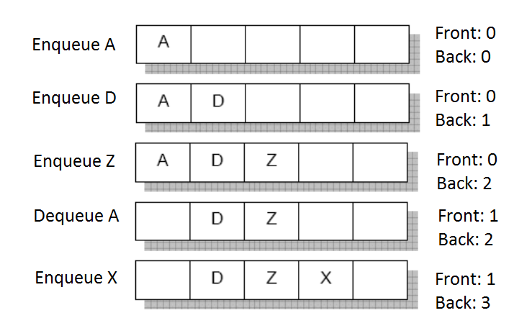
Queue Example:

Slide 8
Thanks For Listening!

